Slide 1
8th Edition: Smart cities & Intelligent mobility India 2022
Session: A Deep Dive into the Future of Mobility and Smart Cities with 5G

Slide 2
Overview
According to United Nations, by 2030, the world will reach an urbanization rate of 60.4%.
  Smart cities will create a more efficient way of life for its citizens and help boosting economic growth.
  Development and deployment of technology will play a crucial role in the way that cities of the future capitalize on the use of data – especially in the context of mobility and transport.
In view of above, Government of India introduced “Smart Cities Mission” initiative on 25th June 2015 to develop 100 smart cities all over the country to:
  drive economic progress
  boost the quality of life by fueling local development and harnessing technology to create smart outcome for the citizens.

Slide 3
India – Policy

Slide 4
Smart City Mission
100 smart cities selected in four rounds with a target for its completion by 2019-20, but has since been extended and now effective until June 2023
According to latest data provided by Ministry – MoHUA (as of July 5, 2022):
  7,825 projects worth Rs 1,90,878 crores have been tendered
  work orders for 7,650 projects worth Rs 1,81,113 crore have been issued, and
  4,035 projects worth Rs 66,343 crores have been completed.
Varanasi, Bhopal, Indore, Surat, Bhubaneshwar, and Ahmedabad are considered to be said as first smart cities of India.
  Core infrastructure elements:
  Adequate water supply
  Assured electricity supply
  Sanitation, including solid waste management
  Efficient urban mobility and public transport
  Affordable housing, especially for the poor
  Robust IT connectivity and digitalization
  Good governance, especially e-Governance and citizen participation
  Sustainable environment
  Safety and security of citizens, particularly women, children and the elderly, and
  Health and education

Slide 5
Government/Industry Initiatives to support “Smart City Mission”
Open Data Platform/India Urban Data Exchange (IUDX) by Ministry of Housing and Urban Affairs (MoHUA):
IUDX, an open-source software platform for Indian Smart cities facilitating secure and authenticated exchange of data amongst various data platforms, 3rd party applications, data producers and consumers. IUDX has also become first software platform to fully adopt BIS standards for Unified Data Exchange
  Unified Data Exchange standard – IS 18003, for Indian Smart Cities to ensure a secure and sustainable digital infrastructure and to facilitate the implementation of various smart city projects.
National Urban Digital Mission (NUDM) by MEITY:
to establish a digital infrastructure & formalize a citizen-centric and ecosystem-driven approach to urban governance and service delivery in cities by 2022.
Smartnet by Ministry of Housing and Urban Affairs (MoHUA):
to create a resource-rich ecosystem of learning, sharing and dissemination for the city managers and primary stakeholders in the urban transformation of India.
Smart City Living Lab:
an open-innovation ecosystem is set up at IIITH, with support from MEITY, Smart City Mission, Govt of Telangana in collaboration with technology partners EBTC and Amsterdam Innovation Arena with an aim to discover & develop cutting edge innovations with smart city use cases and enrich them with the knowledge from research.
Freight Smart Cities by Commerce Ministry’s Logistics Division:
to improve the efficiency of urban freight and create an opportunity for the reduction in logistics costs.

Slide 6

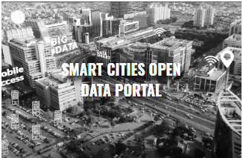


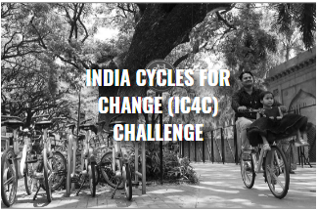
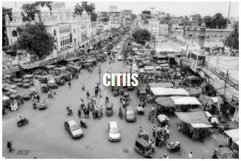
Other Initiatives

Slide 7
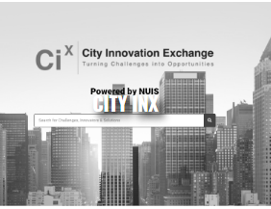



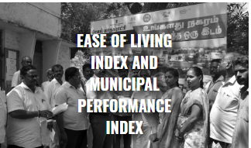
Other Initiatives

Slide 8
Europe – Policy

Slide 9
Smart Cities Marketplace: Europe
Smart Cities Marketplace was created by merging two former platforms, the “Marketplace of the European Innovation Partnership on Smart Cities and Communities (EIP-SCC Marketplace)” and the “Smart Cities Information System (SCIS)”.
  to bring cities, industries, SMEs, investors, banks, researchers and many other smart city actors together.
Marketplace's main areas of cross-cutting operation include:
  sustainable urban mobility
  integrated infrastructures and processes in energy, ICTs and transport
  sustainable districts and built environment
  citizen focus
  policy and regulation
  integrated planning and management
  knowledge sharing
  baselines, performance indicators and metrics
  open data governance and standards
  business models, procurement and funding..

Slide 10
Many other EU initiatives focusing on making Smart Cities
European Energy Research Alliance (EERA) Joint Programme Smart Cities:
  It aims to develop new scientific methods, concepts and tools designed to support European cities in their transformation into smart cities. The key focus is on large
CIVITAS:
  a network of cities for cities dedicated to cleaner, better transport in Europe and beyond.
EIT Urban Mobility:
  an initiative of the European Institute of Innovation and Technology (EIT), acts to accelerate positive change on mobility to make urban space more liveable.
Eltis:
  It facilitates exchange of information, knowledge and experience in the field of sustainable urban mobility in Europe.
BRIDGE:
  It unites Horizon 2020 & Horizon Europe Smart Grid, Energy Storage, Islands, and Digitalisation Projects to create a structured view of cross-cutting.
Intelligent Cities Challenge
  It supports 136 cities in using cutting-edge technologies to lead the intelligent, green and socially responsible recovery
Many more….

Slide 11
Smart Mobility & 5G

Slide 12

Smart Mobility (ITS) for Smart Cities
Smart Mobility (ITS)
  add information and communications technology (ICT) to transport infrastructures and vehicles to improve their road safety, reliability, traffic efficiency and quality.
  is a wholistic system comprising not only Intelligent Vehicles & Road Transport system but it also includes railways, aviation and maritime as well.
  use cases include In vehicle information, Traffic lights, Emergency vehicle on approach, traffic jam, Parking guidance etc.
Notes:
CEPT: European Conference of Postal and Telecommunications Administrations
EC: European Commission.

Slide 13
Why is 5G is vital to the advancement of smart cities?
With 5G everything from smart sensors to smart mobility, self-driving cars will be able to communicate at incredibly fast speeds with low latency resulting in more efficient systems and resources for smart cities and it will address:
  Public Safety and Security:
    Emergency officials will be able to locate and receive real-time information regarding accidents and emergency calls from intelligent sensors that are placed throughout the city.
  Mobility:
    5G networks will provide faster and lower latency connectivity for mobility, making it easier for autonomous vehicles and people to navigate cities.
    Better Traffic Management by the combination of 5G networks and IoT devices are expected to intelligently track and manage traffic flows, monitor road conditions, and reduce traffic congestion.
  Smart healthcare: reform towards a fair, accessible and universal healthcare system:
    5G network along with general technologies such as big data, AI and cloud computing, provides an effective, real-time data solution, and inspires innovative methods and ideas for the screening and treatment of contagious diseases.
  Energy Efficiency:
    5G creates huge opportunities for connected devices within buildings and cities to help track, monitor, and control energy. This helps buildings and cities better manage their energy supply, save money, and become more sustainable.
  Many more…
Notes:
CEPT: European Conference of Postal and Telecommunications Administrations
EC: European Commission.

Slide 14
Standards

Slide 15
Role of Standards in Smart Cities
Underpinning common understanding
Enabling integration between systems, and between the physical and the digital world
  Accelerating smart city solutions and deployment
  Provide confidence in the market & Preventing vendor lock-in
  Enabling scaling and replicability of urban solutions
  Facilitating a collaborative, consensus-driven process open to all stakeholders
  Because STD will create Smart Cities in response to the market and final beneficiaries needs (cities and citizens)
Notes:
STD can help provide a shared common language and this is critically important because of the wide set of stakeholders involved.
Phy and DIG= cities need reliable and resilient physical and tech infrastructures, working together
One of the most important characteristic of SC is interoperability and coherence between separate systems and services. STD can help define those points of interoperability
The ESOs and their members have an enormous n of std developed in several TCs existing or proposed that are relevant for sc. At the present those TSD broadly concern specific issues rather than dealing with horizontal cross-cutting issues. This is issue is likely to continue since dedicated std are needed for individual applications (transport, healthcare), but a common framework is needed that’s why the CG
Market They can support industrialization of solutions and Speed replicability
- STD can help prevent vendor lock-in = when products and services are built to widely agreed std, it makes it possible to break things down into smaller parts and find the best providers of each of them, rather than having to contract with a single company to offer the whole product.
-STD enabling scale= the use of std ensure cities are following a path taken by many others. Having many cities following a common path will stimulate the market to further support this path and the roll-out of integrated, scalable SC solutions
-STD help to develop and manage a SSCC Strategy and Implementing and managing Smart City projects (align approaches), is the complexityof the city itself and of the (decision-making) processes that need to be put in motion
- Standards are enablers for the seamless integration of city systems, functions, applications and services and for the technologies and communications infrastructures underpinning these.

Slide 16









EU, India & Global Standardization activity
ISO/TMB/
Smart Cities SAG + TF
ISO/TC 268 ISO/TC 268/SC 1
IEC SyC
Smart cities
BIS
CED 59: Smart Cities Sectional Committee
LITD 28: Smart Infrastructure
Jointly with IEC and ITU
CEN-CENELEC-ETSI Sector Forum on SSCC
ITU-T/FG
SSC
ISO-IEC/JTC 1 WG 11
transposed oneM2M Release 2 and Release 3
CEN/TC 465 ‘Sustainable and Smart Cities and Communities’
Technical Committees
Standardization Development
(Standards, TS, TR, PAS…)

Slide 17
Smart City Standardization: India
Bureau of Indian Standards, National Standard Body of India, through its technical committees have been developing standards related to smart cities.
CED 59: Smart Cities Sectional Committee
LITD 28: Smart Infrastructure
Telecommunications Standards Development Society, India (TSDSI):
transposed oneM2M Release 2 and Release 3
produced several technical reports on M2M Use Cases in different verticals from Indian Context
Telecommunication Engineering Centre (TEC):
adopted TSDSI-transposed oneM2M (Release 2) standards and 3GPP standards (402 nos.) for adoption as national standards
released various technical reports related to smart cities
C-DOT, has also developed oneM2M standards based Common Services Platform (CCSP) for IoT which is of tremendous value to Smart city applications developers. IA 18004-1: 2021 is based on oneM2M CSF
List of Standards developed by CED 59 related to smart cities
Sl No | IS_No | Title
1 | IS 17000 : 2019 | Sustainable Development of Habitats Indicators
2 | IS 17451 : 2020 | Smart Community Infrastructure - Best Practices for Transportation - Guidelines
3 | IS 17456 : 2020 | Smart Community Infrastructure Guidance on Smart Transportation for Allocation of Parking Lots in Cities
4 | IS 17457 : 2020 | Sustainable Development of Habitats - Vocabulary
List of Standards developed by LITD 28 related to smart cities
Sl No | IS_No | Title
1 | IS 802.15.4:2021 | Low-Rate Wireless Networks (Adoption of IEEE 802.15.4)
2 | IS 18002-1:2021 | Unified Digital Infrastructure Data Layer Part 1 Reference Architecture
3 | IS 18003-2:2021 | Unified Data Exchange Part 2 API specifications
 |  | (includes NGSI-LD (ETSI CIM)
4 | IS 18008-1:2021 | Smart Cities- GIS Part 1 Reference Architecture
5 | IS 18006-1:2021 | Municipal Governance - Part 1 Reference Architecture
6 | IS 18006-3-1:2021 | Municipal Governance Part 3 Property Tax Section 1 Taxonomy
7 | IS 18004-1:2021 | IoT System Part 1 Reference Architecture
 |  | (based on oneM2M CSF )

Slide 18
ITS Standardization: India
Bureau of Indian Standards (BIS):
TED 28-Intelligent Transport Systems Sectional Committee of Bureau of Indian Standards (BIS) is responsible for
  Standardization of information, communication and control systems in the field of urban and rural surface transportation, including intermodal and multimodal aspects thereof, traveller information, traffic management, public transport, commercial transport, emergency services and commercial services in the intelligent transport systems
  Co-ordination of work with ISO/TC 204 excluded in-vehicle transport information and control systems (ISO/TC 22) and ISO/TC 241
  Published around 20 standards
Automotive Research Association of India (ARAI):
Government approved test agency to carry out mandatory certification testing
Provides technical expertise in R&D, test, certification, homologation and framing of vehicles regulations.
Published/drafted several standards that are related to electric/smart mobility
  AIS-140 & Amd 1 and 2: Intelligent Transportation Systems (ITS) - Requirements for Public Transport Vehicle Operation

Slide 19
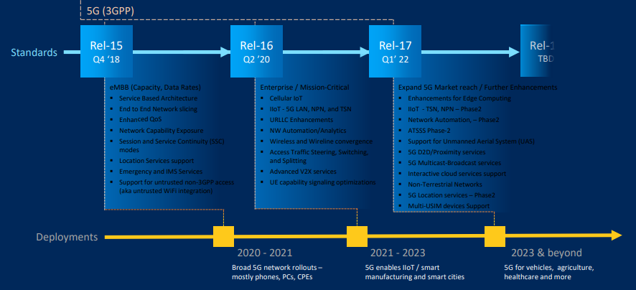
5G: Evolutionary and Revolutionary

Slide 20
Conclusion
Smart cities are in essence data-driven urban spaces. As a result, the use of Smart Mobility forms the foundation of smart city architecture.
  deployment of ITS means the integration of advanced information and communication-based technologies into the mobility infrastructure of the city.
Standards also play an important role in building a smart city:
  Provide the right conditions for open innovation and reduces barriers to integration (includes APIs)
  Enables collaboration, open ecosystem and Open innovation
  Resulting in productivity increase and service transformation
5G will profoundly impact economies and societies as it will provide the necessary communication infrastructure required by various smart city applications.
  ITS is one of the many smart city applications that can be realized via 5G technology.
Notes:
CEPT: European Conference of Postal and Telecommunications Administrations
EC: European Commission.

Slide 21

Dinesh Chand Sharma
(Seconded European Standardization Expert in India)
Director – Standardization & Public Policy
SESEI C/O EBTC, DLTA Complex, Gate No 3, 1st Floor, 1, Africa Avenue, New Delhi 110029
Mobile: +91 9810079461, Tel: +91 11 3352 1525, dinesh.chand.sharma@sesei.eu
www.sesei.eu ⬄ www.sesei.in

