Slide 2
Contents
“Smart City Mission” - overview
Mission strategy
Core infrastructure elements
Status of the mission
Government/Industry Initiatives to support the “Smart City Mission”
Countries supporting Indian “Smart City Mission”
Key Challenges
Standardization Activities for Smart cities
Conclusion

Slide 3
“Smart City Mission” - Overview

Slide 4
Smart City Mission – Overview
As per the Census 2011, Indian cities can accommodate nearly 31% of Indian population and contribute 63% of GDP.
This requires comprehensive development of physical, institutional, social and economic infrastructure to improve the quality of life and attracting people and investment, setting in motion a virtuous cycle of growth and development.
Government of India introduced “Smart Cities Mission” initiative on 25th June 2015 to develop 100 smart cities all over the country and drive economic progress and boost the quality of life by fueling local development and harnessing technology to create smart outcome for the citizens.
will be operated as a Centrally Sponsored Scheme (CSS) and Ministry of Housing and Urban Affairs (MoHUA) is responsible for implementing mission in collaboration with state government
Process started with the formation of an implementing agency, a special purpose vehicle (SPV) which is promoted by the state/Union Territory and the urban local body and having a 50% equity shareholding of each side.
Mission involves a 50:50 financing model with the Centre initially contributing Rs 500 crore (Euro ~58M) and the state giving an equal share for five years.
SPV, formed as a limited company and is governed by the Indian Companies Act, 2013.
Aimed to be completed by 2019-20, but has since been extended and now effective until June 2023

Slide 5
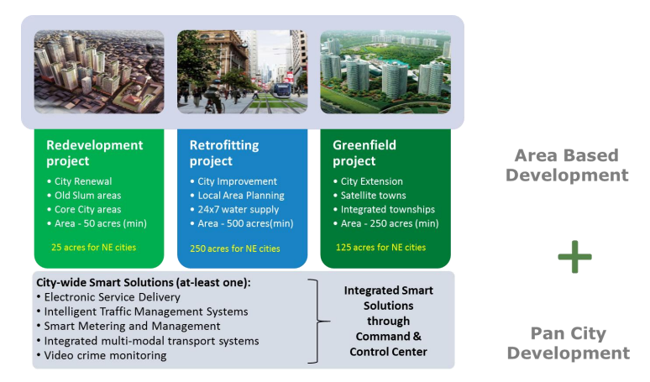
Mission strategy
Strategic components of area-based development (ABD) are:
City renewal (redevelopment)
City improvement (retrofitting)and
City extension (Greenfield development)
Strategic components of Pan-city development are:
Use technology, information and data to make existing city-wide infrastructure and its services better.
For example, applying Smart Solutions in transport sector (intelligent traffic management system) and reducing average commute time or cost of citizens, which will have positive effects on productivity and quality of life of citizens.
Another example can be wastewater recycling and smart metering which can make a huge contribution to better water management in the city.

Slide 6
Core infrastructure elements
Adequate water supply
Assured electricity supply
Sanitation, including solid waste management
Efficient urban mobility and public transport
Affordable housing, especially for the poor
Robust IT connectivity and digitalization
Good governance, especially e-Governance and citizen participation
Sustainable environment
Safety and security of citizens, particularly women, children and the elderly, and
Health and education

Slide 7
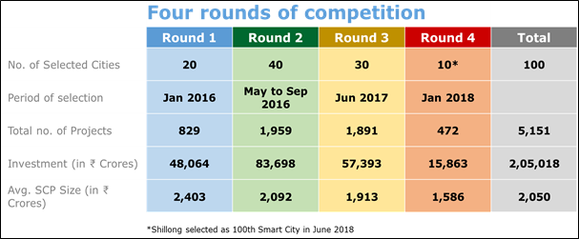
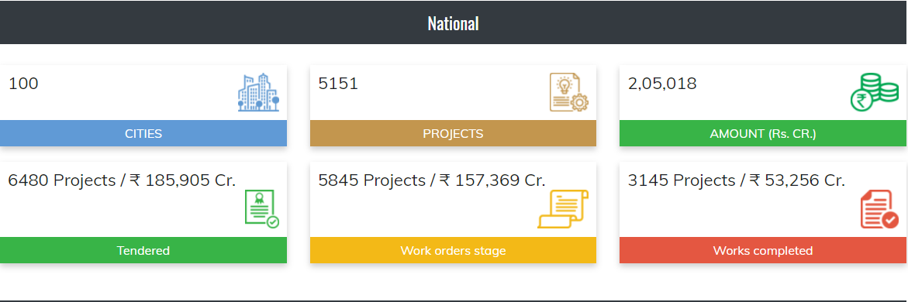
Status of Smart city mission
Govt. selected 100 cities through a City Challenge Process of four rounds:
In Round 1, 20 smart cities were selected in January 2016, and in May 2016, 13 more cities were selected in a fast-track round.
In Round 2, 27 smart cities were selected in September 2016.
In Round 3, 30 smart cities were selected in June 2017.
In Round 4, 9 smart cities were selected in January 2018.
Indian State Meghalaya’s capital, Shillong, was included as the 100th city in June 2018
According to latest data provided by Ministry - MoHUA:
total proposed investments for SCM stood at ~Rs. 205,018 crore (€24.4 billion).
6480 projects worth ₹ 185,905 crore (€22.13 billion) have been tendered,
Work orders issued for 5845 Projects worth ₹ 157,369 crore (€18.73 billion) and
3145 Projects worth ₹ 53,256 crore (€6.34 billion) have been completed.

Slide 8
Government/Industry Initiatives to support “Smart City Mission”

Slide 9
Open Data Platform/India Urban Data Exchange (IUDX)
IUDX, an open-source software platform for Indian Smart cities, facilitates secure and authenticated exchange of data amongst various data platforms, 3rd party applications, data producers and consumers.
Platform is developed in partnership between Smart Cities Mission and the Indian Institute of Science (IISc), Bengaluru.
Platform will provide full control to the data owners as to what data need to be exposed and to whom.
IUDX, has successfully deployed operational data exchanges in 10 Indian cities and will now be entering its next phase to be deployed in 25 more smart cities
Operational Cities are Pune, Surat, Varanasi, Agartala, Bengaluru, Bhubaneswar, Chennai, Bhopal, Faridabad, and Vadodara.
Ministry of Housing and Urban Affairs (MoHUA) through Smart Cities Mission (SCM) has sanctioned INR 29 crores (Euro 3.4M) to support the ambitious goals of this program for the financial years 2021-22 and 2022-23
IUDX has also become first software platform to fully adopt BIS standards for Unified Data Exchange
Unified Data Exchange standard – IS 18003, for Indian Smart Cities to ensure a secure and sustainable digital infrastructure and to facilitate the implementation of various smart city projects.

Slide 10
National Urban Digital Mission
On February 23, 2021, National Urban Digital Mission (NUDM) was launched by Ministry - MoHUA along with Ministry - MEITY, to establish a digital infrastructure & formalize a citizen-centric and ecosystem-driven approach to urban governance and service delivery in cities by 2022.
Vision: to improve ease of living for citizens by creating a national urban digital ecosystem that delivers accessible, inclusive, efficient and citizen centric governance in India’s 4400 towns and cities.
Objectives: NUDM envisages few of the following objectives:
To create shared digital infra as a public good in the shape of state-of-the-art digital urban platforms.
To catalyze an urban national open digital ecosystem (u-NODE) that leverages NUDM.
To establish registries at appropriate levels to a create single source of truth in respect of urban assets, service delivery, urban data and the actors.
To promote the development of nationally scalable application systems with a special focus on achieving the Sustainable Development Goals for urban.
To adopt the best principles of cooperative federalism while working with the States, Union Territories & Urban Local Bodies.
To enhance the efficiency and effectiveness of governance at all levels.
To create open standards and enforce the adoption of open standards by all national digital urban stakeholders.
To strengthen existing urban systems and applications, by ensuring their conformity with the defined standards and integration with the proposed NUDM.

Slide 11
SmartNet
Smartnet is an initiative of Ministry of Housing and Urban Affairs (MoHUA) and is aimed:
to create a resource-rich ecosystem of learning, sharing and dissemination for the city managers and primary stakeholders in the urban transformation of India.
key objectives are:
Providing a horizontal learning and knowledge sharing platform for exchange between cities, practitioners, academia, researchers and technologists.
Evolving a comprehensive framework to visualize and articulate the government's urban missions such as smart cities, AMRUT, Housing for All, HRIDAY and Swacch Bharat.
Smartnet also encourages Govt. to Govt.(G-to-G), Govt. to Businesses (G-to-B) and Businesses to Government (B-to-G) linkages in urban India for enabling transparent and structured interactions between cities, businesses and institutions.
Smartnet provides a platform for industries to showcase their ideas and innovations developed for cities.
portal will provide users real time information through City Dashboards, capturing changes at City level, project level information through geo-tagging of projects and latest updates on the progress of the urban sector missions.

Slide 12
Smart City Living Labs
Smart City Living Lab, an open-innovation ecosystem is set up at IIITH, with support from Ministry - MEITY, Smart City Mission, Govt of Telangana in collaboration with technology partners EBTC and Amsterdam Innovation Arena with an aim:
to discover & develop cutting edge innovations with smart city use cases and enrich them with the knowledge from research.
Living Lab shall help:
Get expertise in IoT for Smart Cities related research and deployment
Generate data for research
Creation of a viable innovation and demand driven ecosystem in universities.
Provide a test bench for IoT based Smart City implementations to start-ups as well as big companies
IIITH campus would include different IoT verticals related to air quality, building energy, water quantity and quality, street lighting, etc.
Project Urban Living Lab in Panaji, Goa is a joint initiative between India and Denmark and is implemented under the MoU between the Royal Danish Embassy and the Imagine Panaji Smart City Development Limited (IPSCDL).

Slide 13
Freight Smart Cities Plan
In July 2021, Commerce Ministry’s Logistics Division unveiled plans for ‘Freight Smart Cities’
The objective is to improve the efficiency of urban freight and create an opportunity for the reduction in logistics costs. The initiative encompasses the following plan:
Phase I – Identification of the initial 10 cities to be developed as ‘Freight Smart Cities’
Target segment includes all state capitals and cities that have >1 million population
Formation of city-level logistics committees in 10 cities – including member participation from the government and the private sector
These committees shall co-create ‘City Logistics Plans’ such as promoting electrification of urban freight, building peri-urban freight centers, developing truck routes and managing night-time deliveries
Expansion of initiative to next 75 cities in Phase II
On the Freight Smart City initiatives, Logistics Division is also working closely with GIZ (Germany) under Indo-German Development Cooperation, Rocky Mountain Institute (RMI).

Slide 14

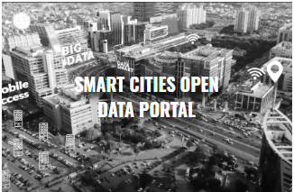


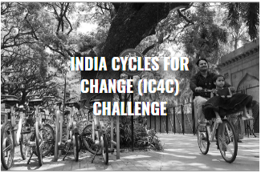
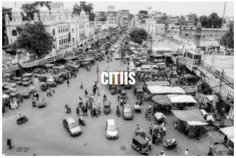
Other Initiatives

Slide 15
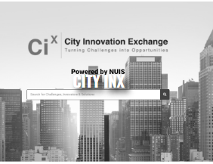
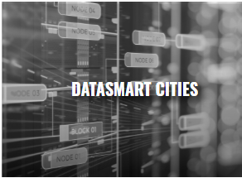


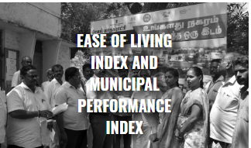
Other Initiatives

Slide 16
Countries supporting India’s Smart City Mission

Slide 17
Countries supporting Smart City Mission
Leading economies worldwide have shown interest in India’s smart city mission and are looking forward to participate in the development of smart cities:
Spain has proposed to cooperate with India to develop Delhi into smart cities. The Barcelona Regional Agency of Spain has shown an interest in exchanging technology with India .
Germany to support in developing Bhubaneswar (Odisha), Kochi (Kerala) and Coimbatore (Tamil Nadu) as smart cities .
France to support three Indian cities—Chandigarh, Nagpur and Puducherry and it has announced an investment of US$ 1.5 billion (EUR 1.3 billion) .
Sweden, Israel, the Netherlands, the UK and Hong Kong have also shown interest in investing in India for developing smart cities.
Italy to invest US$ 1.2 trillion over the next 20 years through numerous initiatives
United States ‘Trade and Development Agency (USTDA) to develop Visakhapatnam (Andhra Pradesh), Allahabad (Uttar Pradesh) and Ajmer (Rajasthan) as smart cities .
Japan has decided to assist India with the development of Chennai, Ahmedabad and Varanasi as smart cities.
Singapore offered to help developing Amravati, the new capital of Andhra Pradesh, as a smart city.
Twenty cities across three Indian states — Punjab, Haryana and Rajasthan — are likely to have a fast-track development under a new Indo-Canadian initiative to train smart city planners on capacity building, governance, reform implementation, water supply and sewerage, among others.

Slide 18
Key Challenges
1. Insufficient fund at state level
2. Absence of master plan or city development plan
3. Lack of advanced Technology Solutions
4. Cybersecurity risks

Slide 19
Standards for Smart Cities

Slide 20
Telecommunications Standards Development Society, India (TSDSI)
TSDSI, an autonomous, membership based, standards development organization (SDO) for Telecom/ICT products and services in India,
develop standards for access, back-haul, and infrastructure systems, solutions and services that best meet India specific Telecom/ICT needs, based on research and innovation in India.
works closely with global standards’ bodies (3GPP, oneM2M, ETSI, etc) to reflect Indian requirements into international telecom/ICT standard
TSDSI has transposed oneM2M Release 2 and Release 3 and handed over these releases to TEC/DoT for its adoption.
Subsequently, TEC has adopted oneM2M Rel2 as national standard and is in the process of adopting oneM2M release 3 specifications as national standards.
TSDSI has also produced a number of technical reports on M2M Use Cases in different verticals from Indian Context
C-DOT, an Indian Government owned telecommunications technology development center, has also developed oneM2M standards based Common Services Platform (CCSP) for IoT which is of tremendous value to Smart city applications developers.

Slide 21
Telecom Engineering Centre (TEC)
TEC, National Standardization Body for Telecom and related ICT sector in India, issued its “Standardization Guide – A policy document for adoption of Domestic/ international standards into national standards” in May 2020
TEC, after complying with the due consultation process and as per the Standardization guide, adopted TSDSI-transposed oneM2M Release 2 specifications as National standards and is also working on the adoption of oneM2M release 3 specifications.
These standards will be quite useful for the development of interoperable ecosystem for IoT domain, especially for Smart cities.
TEC has also prepared and released following technical reports related to smart cities:
ICT Deployments and strategies for India’s smart cities: A curtain raiser
M2M/ IoT Enablement in Smart Homes
Design and Planning Smart Cities with IoT/ ICT
IoT/ ICT Enablement in Smart Village & Agriculture
IoT/ ICT standards for Smart Cities (under preparation)
TEC has also made a significant contribution to ITU-T Recommendation
Y Suppl. 53 (12/2018) on IoT having five IoT use cases from India & one from Egypt.
Y Suppl. 56 (12/2019) on Smart city having smart city use cases from Japan, Korea, UK and India.

Slide 22
Bureau of Indian Standards (BIS)
Bureau of Indian Standards (BIS), National Standard Body of India, through its technical committees have been developing standards related to smart cities.
Civil Engineering Division Council
CED 59: Smart Cities Sectional Committee
Electronics and information Technology division council (LITD)
LITD 17: Information Systems Security And Privacy
LITD 27: IoT and related technologies
LITD 28: Smart Infrastructure
LITD29: Blockchain and Distributed Ledger Technologies
LITD 30: Artificial Intelligence
LITD 31-Cloud Computing, IT & Data Centers
List of Standards developed by CED 59 related to smart cities
Sl No | IS_No | Title
1 | IS 17000 : 2019 | Sustainable Development of Habitats Indicators
2 | IS 17451 : 2020 | Smart Community Infrastructure - Best Practices for Transportation - Guidelines
3 | IS 17456 : 2020 | Smart Community Infrastructure Guidance on Smart Transportation for Allocation of Parking Lots in Cities
4 | IS 17457 : 2020 | Sustainable Development of Habitats - Vocabulary
List of Standards developed by LITD 28 related to smart cities
Sl No | IS_No | Title
1 | IS 802.15.4:2021 | Low-Rate Wireless Networks (Adoption of IEEE 802.15.4)
2 | IS 18002-1:2021 | Unified Digital Infrastructure Data Layer Part 1 Reference Architecture
3 | IS 18003-2:2021 | Unified Data Exchange Part 2 API specifications
 |  | (includes NGSI-LD (ETSI CIM)
4 | IS 18008-1:2021 | Smart Cities- GIS Part 1 Reference Architecture
5 | IS 18006-1:2021 | Municipal Governance - Part 1 Reference Architecture
6 | IS 18006-3-1:2021 | Municipal Governance Part 3 Property Tax Section 1 Taxonomy
7 | IS 18004-1:2021 | IoT System Part 1 Reference Architecture
 |  | (based on oneM2M CSF )

Slide 23
Conclusion
Government is driving the Smart Cities mission, but progress is slow.
Due to Covid-19 pandemic and other reasons have also caused delay in execution of most of the smart city projects, therefore government has extended the timeline for the implementation of Mission to June 2023
Financing is also the greatest challenge for smart city projects
Smart city infrastructure requires a large capital investment
Many states/union territories have failed to release their share of funds for the mission.
Smart cities need greater cooperation within national and International experts
Mission is indeed smart and evolving hence need careful planning, proper implementation and continuous monitoring.
Standard based product and solution implementation is of utmost important

Slide 24

Dinesh Chand Sharma
(Seconded European Standardization Expert in India)
Director – Standardization & Public Policy
SESEI C/O EBTC, DLTA Complex, Gate No 3, 1st Floor, 1, Africa Avenue, New Delhi 110029
Mobile: +91 9810079461, Tel: +91 11 3352 1525, dinesh.chand.sharma@sesei.eu
www.sesei.eu ⬄ www.sesei.in

